Slide 1
Superstore Sales Dashboard
An Interactive Business Intelligence Dashboard Using Power BI
Presented by
Dhana Lakshmi Kotupalli

Slide 2
Project Objective
To analyze and visualize Superstore sales data using Power BI
Provide business insights using key metrics: Sales, Profit, and Orders
Enable stakeholders to explore trends by category, region, and time
Improve decision-making through interactive dashboards

Slide 3
Dataset Overview
Dataset Description:
Source: [Kaggle – Superstore Sales Dataset]
Rows: ~10,000 records
Key Columns:
Order ID, Order Date, Sales, Profit, Quantity, Discount, Category, Region, Segment
Data Cleaning Performed:
Removed duplicates
Checked for nulls
Verified data types

Slide 4
Screenshots of KPI Cards
Dashboard Design Highlights:
Key KPIs:
💰 Total Sales
📈 Total Profit
📦 Total Orders
🧮 Profit Margin

Slide 5
Visuals Used:
Line chart for monthly sales trend
Bar and donut charts for category/region/segment analysis
Slicers for filtering by category, region, date
Interactive, user-friendly design with consistent color theme

Slide 6
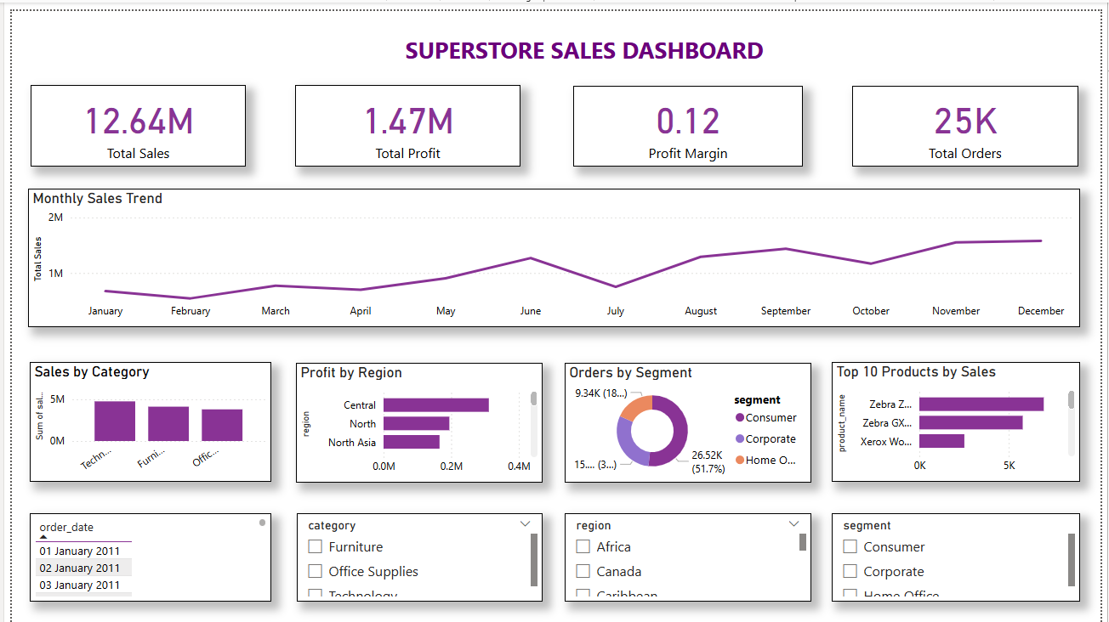
Power BI Dashboard

Slide 7
Business Insights
Technology category leads in both Sales and Profit
Central region has strong performance, but South shows low profit margin
Q4 has the highest sales volume consistently
High discounts correlate with lower profitability in some sub-categories

Slide 8
Summary & Next Steps
Dashboard enables quick business overview with drill-down capability
Actionable insights to optimize product focus and regional strategies
Can be extended to include customer behavior and forecasting
Next step: Deploy to Power BI Service for executive-level access

Slide 9
View project on GitHub:
https://github.com/DhanaLakshmiKotupalli/Superstore-Sales-Dashboard-Power-BI-Project

Slide 10
THANK YOU

